Slide 1


Cloud Native Applications
Introducing Spring Cloud Netflix
Notes:
Resting slide on screen before you begin presenting.

Slide 2


Cloud Native Architectures
Light Side of the Cloud
Scalability
High Availability
Velocity: Continuous Delivery
On-Demand Provisioning

Slide 3

Cloud Native Architectures
Dark Side of the Cloud: Finding Services
Where are you?
Over here!

Slide 4
Cloud Native Architectures
Dark Side of the Cloud: Managing Configuration Differences
I’m a little different!
So am I!
Me too!
Dev
QA
Prod

Slide 5
Cloud Native Architectures
Dark Side of the Cloud: Handling Failure
Uh oh!
Uh oh!
I need you!
I need you!
I need you!
Uh oh!
I broke!

Slide 6
Cloud Native Architectures
Dark Side of the Cloud: Following call graphs
WHAT’S GOING ON?!?

Slide 7

Netflix Cloud Libraries
Netflix needed to be faster to win / disrupt
Pioneer and vocal proponent of microservices – the key to their speed and success
Netflix OSS supplies parts, but it’s not a solution
Notes:
Have to be able to scale in response to surges, add new features rapidly. Can’t go down for maintenance/upgrades.
NetFlix, an undisputed business & technology leader
34% of peak N. American internet traffic from 6-9pm
If speed was why they won, microservices was how
They pioneered / began to popularize micro service concept
All they had was Amazon EC2 back then
They had to invent a distributed platform, cloud native platform with PaaS – like features
They had to invent microservice infrastructure at the application level
All before writing one line of code that relates to the application you and I know as Netflix

Slide 8







Spring Cloud Netflix Components
Ribbon
Archaius
Hystrix
Feign
Zuul
Client
Eureka
Turbine
Server
Notes:
Diving into Spring Cloud Netflix, for example, we see here some of the Netflix OSS projects for which Spring Cloud provides integrations.
Ribbon, the Netflix client-side load balancer, and Eureka, the Netflix discovery server, can be used together as we saw earlier where the client side load balancer loads routing information from the discovery server and applies its own load balancing rules.
Netflix Hystrix is an implementation of a circuit breaker. With Spring annotations, we can use AOP to add fallback commands to methods. We can also automatically report failures and metrics ass streams, in accordance with 12-factor app principles, and Netflix Turbine can collect these streams and provide an aggregated visualization into the state of all circuit breakers in the system.
------------------------------
Auxiliary notes:
Ribbon: A client load balancer. Ribbon loads routing info from Eureka. It has several implementations of load balancing rules. Ribbon is used internally by Feign
Feign: A declarative REST client. Allows annotation of interface to be mapped to endpoints. When combined with Ribbon it adds load balancing capabilities to the client interface
Hystrix: Circuit breaker patter implementation. Via spring annotations add commands to methods using AOP. Protects clients from failures and reports metrics via a stream of HTTP events
Zuul: A set of HTTP filters do add routing, security. On spring its used to create a CORS filter for UI apps to be able to access external services
Archaius: Dynamic configuration management. Used with Spring’s config server to allow dynamic properties loading
Eureka: Discovery server
Turbine: Event aggregation engine. It can combine several streams (hystrix) into one combined view, that can be view later on a dashboard

Slide 9

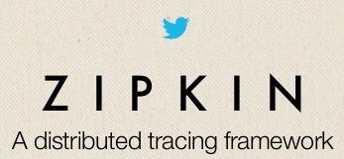
Open Source Cloud Libraries
Companies like Twitter, Facebook, and Hashicorp have open-sourced other cloud infrastructure libraries
Complementary and competing solutions from top technology companies form a bazaar of ideas

Slide 10

Spring Cloud
Easy developer access to a curated selection of open source cloud infrastructure libraries
Additional capabilities include Cloud Connectors and Config Server
Brings the Spring philosophy of convention over configuration, opinionated defaults, and developer simplicity

Slide 11
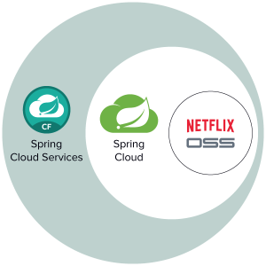
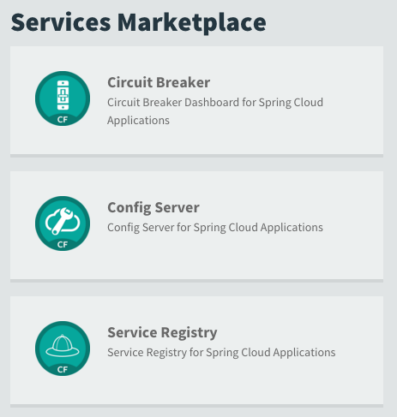
Spring Cloud Services

Slide 12




Spring Cloud Services
Service Registration and Discovery via Netflix OSS Eureka
Registration via CF Route
Service Registry
Git URL for Config Repo provided via Service Dashboard (post-provisioning)
Single tenant, scoped to CF space
Config Server
Spring Cloud
Services
Netflix OSS Turbine + Hystrix Dashboard
Aggregation via AMQP (RabbitMQ)
Circuit Breaker

Slide 13
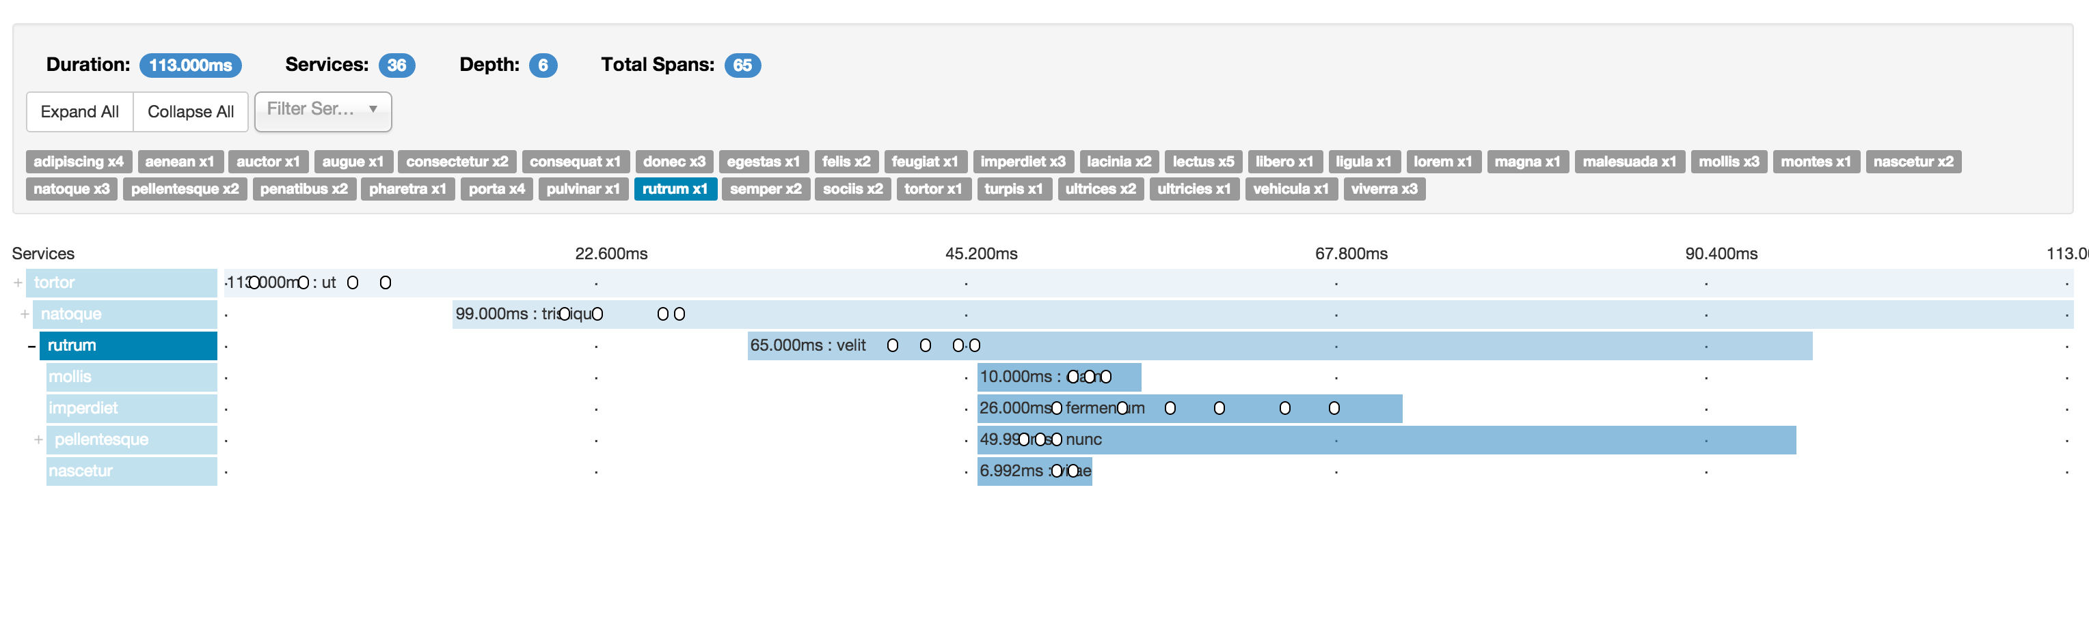
Future: Spring Cloud Sleuth
Distributed Tracing for the Cloud. Invocations are captured in logfiles, remote collector services, and realtime Web UIs.

Slide 14


Open.
Agile.
Cloud-Ready.
Notes:
From Silicon Valley…

